Slide 1


IDS 1721
Computing and Problem Solving for STEM Chapter 04
The Discrete versus the Continuous
Projectile Motion

Slide 2

Projectile Motion
The motion described in launching a projectile is known as 2D motion.
Thus, we will need mathematical equations that describe this motion.
Let’s break this picture down a bit more…
The motion will involve the following:
Position
Velocity
Acceleration
Time
We must be able to break down these quantities in 2D → horizontal and vertical

Slide 3
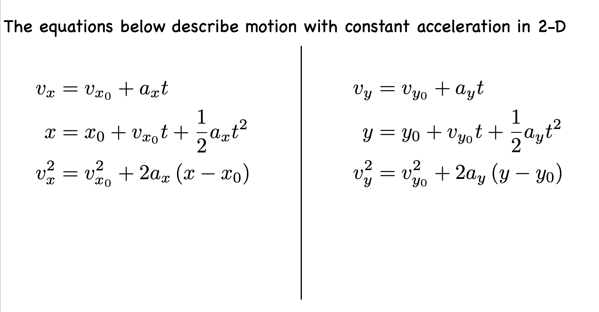
2D Motion
Horizontal Motion
Vertical Motion
Which variable is the same in both directions?

Slide 4
Projectile Motion
The motion described in launching a projectile is known as 2D motion.
Thus, we will need mathematical equations that describe this motion.
Let’s break this picture down a bit more…
What does the projectile depend on?
The motion will involve the following:
Position
Velocity
Acceleration
Time
We must be able to break down these quantities in 2D → horizontal and vertical

Slide 5
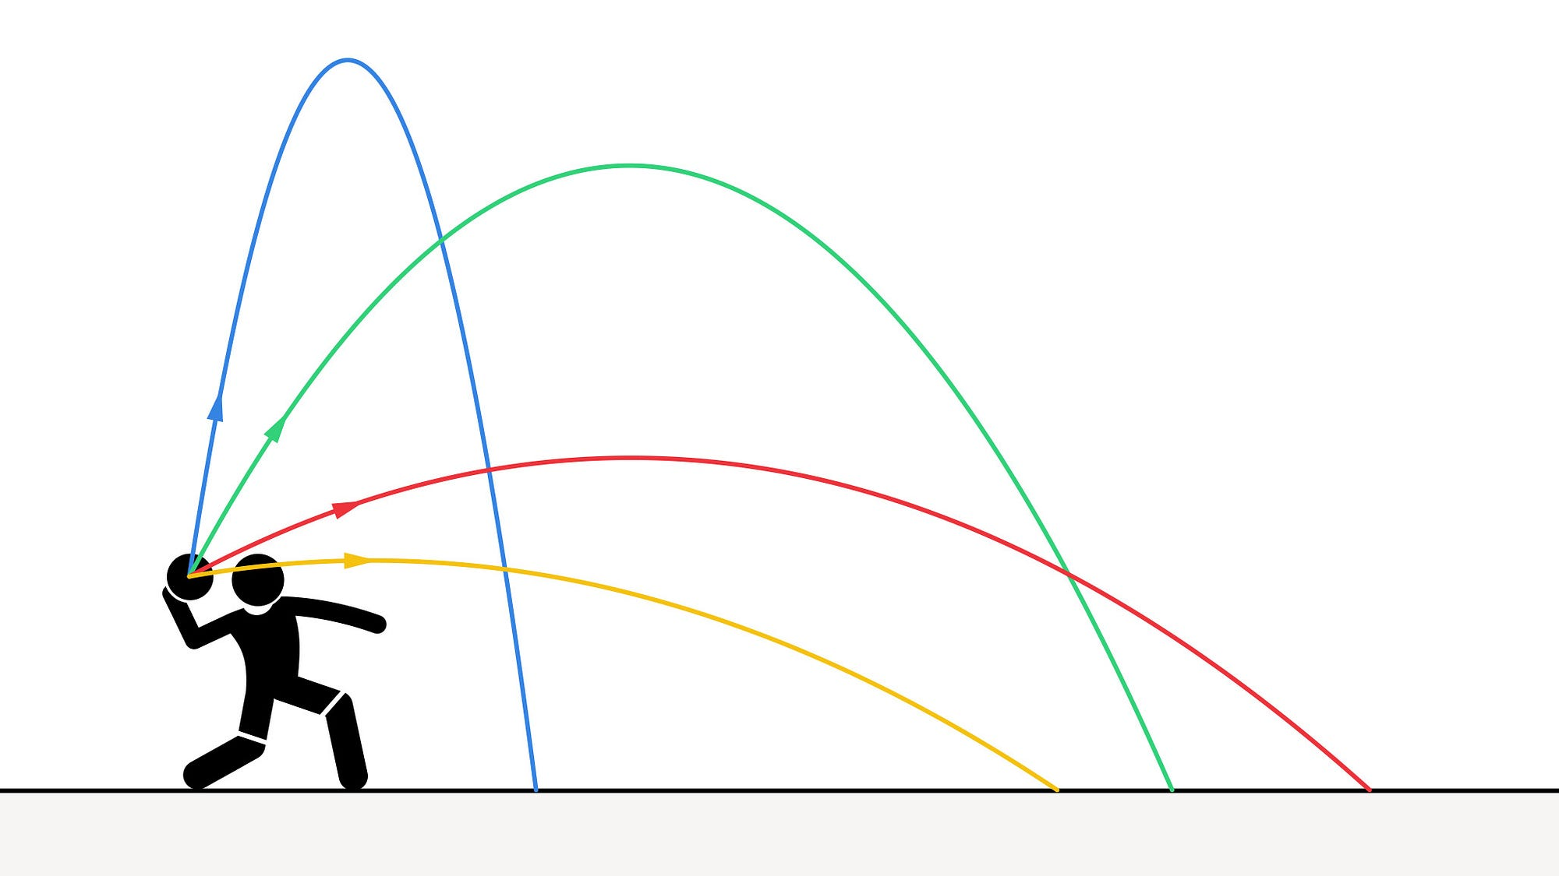
Projectile Motion
The launch angle
The launch speed
Height
What if the angle was zero?
Range
Notice, depending on the angle and speed, the projectile will have a max range and a max height

Slide 6
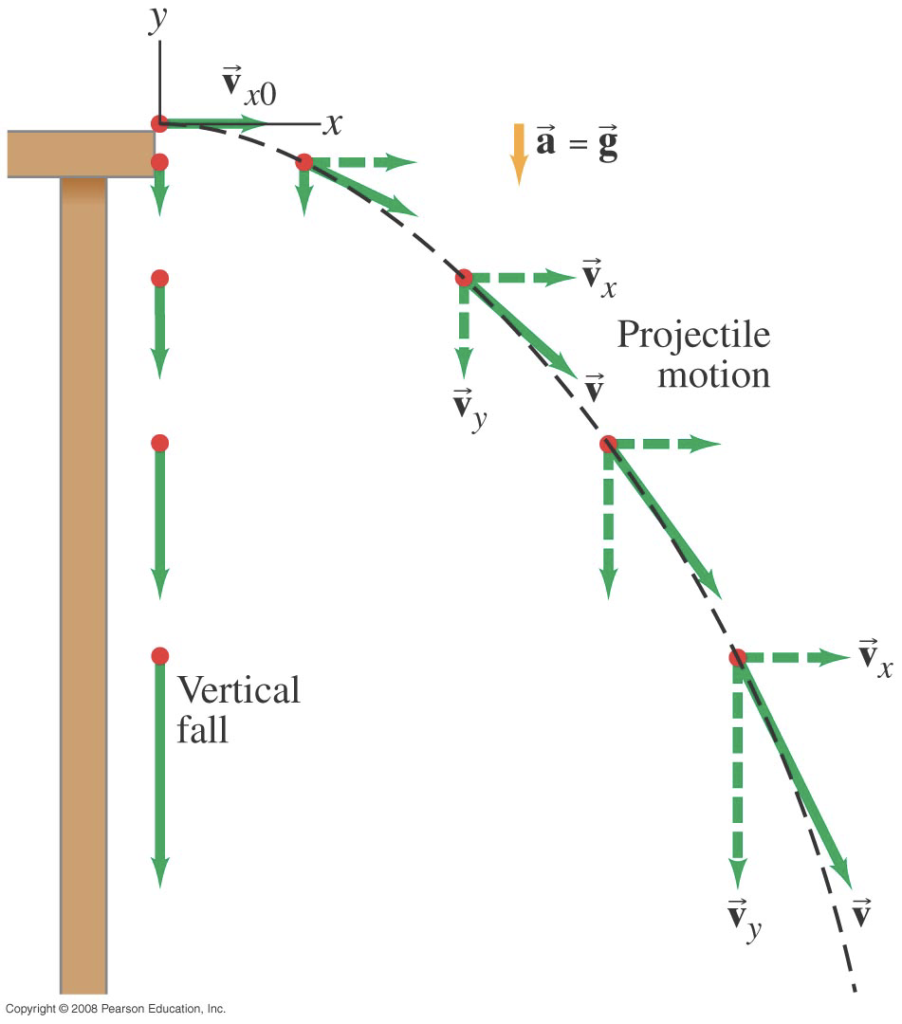
Projectile Motion
Consider a tiny ball rolling off the end of a horizontal table with an initial velocity in the horizontal direction v_{x0}
The velocity vector v at each point is in the direction of motion and thus it is tangent to the path.
Will need to consider the motion in both x and y directions!

Slide 7
Projectile Motion
Let’s look at the vertical component of the motion.
Once the ball leaves the table at t=0
It experiences a vertically downward acceleration g (acceleration due to gravity)
Thus v_{y0} = 0 and v_{y} will increase continually in the downward direction.
Take the y to be positive upward then a_{y} = -g and hence we will get:

Slide 8
Projectile Motion
Let’s look at the horizontal component of the motion.
In the horizontal direction the acceleration is zero a_{x}=0
Hence the horizontal component of the velocity (v_{x0}) remains constant
It has the same magnitude (value) at each point in the path.
So, the horizontal displacement is described by:

Slide 9
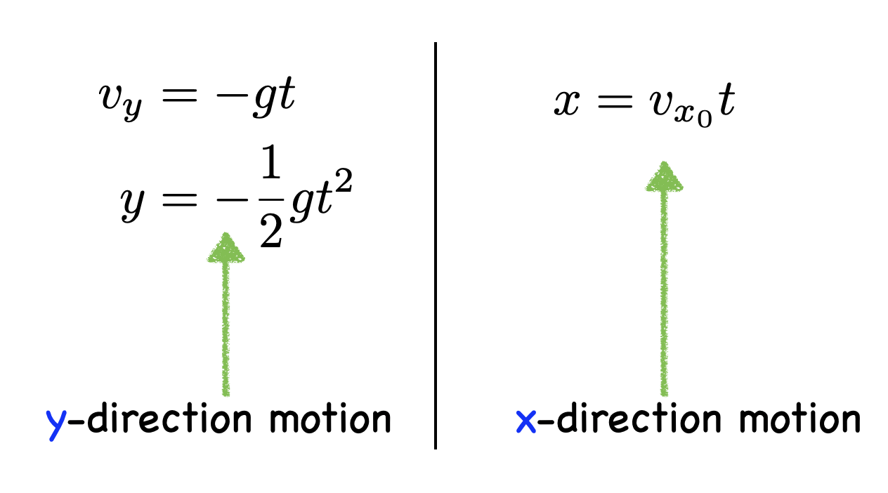
Projectile Motion
Hence, we now have formulated the motion in both the x and y directions!
Let’s try a problem!
For all projectile motion problems, we must look at the motion in both the x and y directions and formulate the equations that relate position, velocity, and acceleration.

Slide 10
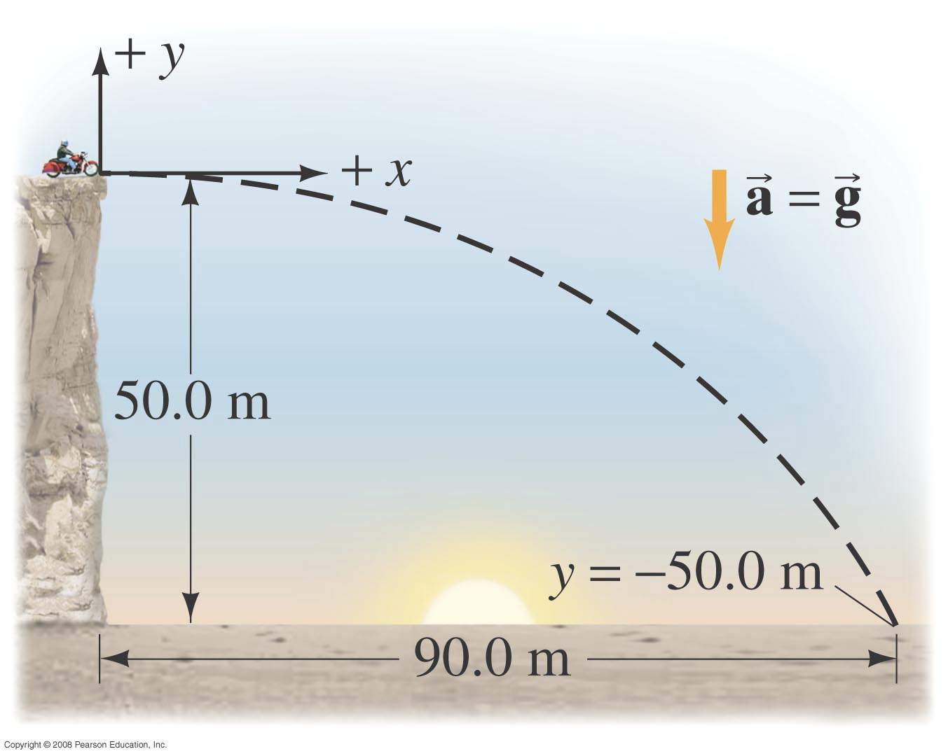
Projectile Motion
In-Class Exercise 1
A movie stunt driver on a motorcycle speeds horizontally off a 50.0-m high cliff. How fast must the motorcycle leave the cliff to land on level ground below 90.0-m from the base of the cliff. (Ignore air resistance)
Make a table of known, unknown, & wanted quantities
Known | Unknown | Want?
x₀ = y₀= 0 | v_{x0} | Horizontal speed (v_{x0})
x = 90.0 m | t
y = -50.0 m
a_{x} = 0
a_{y} = -9.8 m/s²
v_{y0} = 0

Slide 11
Projectile Motion
In-Class Exercise 1
Choose a coordinate system:
y-direction: upward positive
Top of the cliff = y₀
Edge of cliff = x₀
Motorcycle has constant horizontal motion (v_{x})
Time it stays in the air will depend on the y-motion
We will find the time (t) using the y-motion and then use this (t) to find the velocity in the x-direction.

Slide 12
Projectile Motion
In-Class Exercise 1
Known | Unknown | Want?
x₀ = y₀= 0 | v_{x0} | Horizontal speed (v_{x0})
x = 90.0 m | t
y = -50.0 m
a_{x} = 0
a_{y} = -9.8 m/s²
v_{y0} = 0
Remember that we are trying to solve for v_{x0}

Slide 13
Projectile Motion
In-Class Exercise 1
Known | Unknown | Want?
x₀ = y₀= 0 | v_{x0} | Horizontal speed (v_{x0})
x = 90.0 m | t
y = -50.0 m
a_{x} = 0
a_{y} = -9.8 m/s²
v_{y0} = 0
Solve for t here algebraically first!
Then plug in numbers
Then solve for v_{x0} algebraically and use the time we calculated to obtain the speed

Slide 14
Projectile Motion
The launch angle
The launch speed
Height
What if the angle was NOT zero?
Range
This requires a bit more thought!

Slide 15
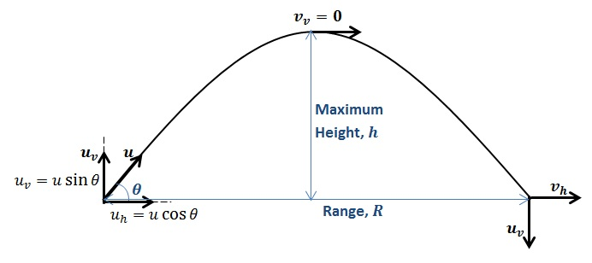
Projectile Motion
Notice now the velocity is broken down into subparts:
u_{h} = ucos(θ) – Horizontal component of the velocity
u_{v} = usin(θ) – Vertical component of the velocity
We also have a range of the projectile and a max height…
We will need to find the total time of flight

Slide 16
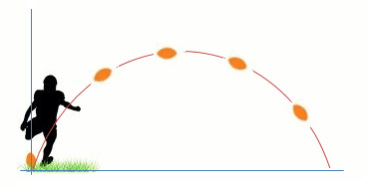
Projectile Motion
In-Class Exercise 2
A football is kicked at an angle of 37 degrees with a velocity of 20 m/s. Let’s calculate:
The maximum height
The time of travel before the football hits the ground
How far away the football lands
We will need to use our equations that describe 2D motion
x-direction
y-direction

Slide 17
Projectile Motion
In-Class Exercise 2
Our first step is to determine the horizontal and vertical components of the velocity (will make life a bit easier for this problem)
Our second step is to determine the time it takes to reach the maximum height
Notice the velocity in the y-direction is zero at the max height!
Thus, we can use the following:

Slide 18
Projectile Motion
In-Class Exercise 2
Doing the algebra and computations:
Third step, we can use this time to get the max height via:
Plug in your values and compute y

Slide 19
Projectile Motion
In-Class Exercise 2
Doing the algebra and computations:
We can use this time to get the max height via:

Slide 20
Projectile Motion
In-Class Exercise 2
To get the time of travel, we can use again
Notice, the initial y position is zero
When the ball lands, the final y position is also zero!
Thus, we can simplify this equation to the following:
Go ahead and solve for t (notice you will have two solutions, since we have a quadratic in t!
Hint: You do NOT need use the quadratic formula → use factoring methods!

Slide 21
Projectile Motion
In-Class Exercise 2
To get the time of travel, we can use again
Notice, the initial y position is zero
When the ball lands, the final y position is also zero!
Thus, we can simplify this equation to the following:
Go ahead and solve for t (notice you will have two solutions, since we have a quadratic in t!
Hint: You do NOT need use the quadratic formula → use factoring methods!

Slide 22
Projectile Motion
In-Class Exercise 2
Thus, working out the algebra, we get:
What do you notice about this total time of flight?

Slide 23
Projectile Motion
In-Class Exercise 2
Our last part is asking for the total horizontal distance traveled…Use the appropriate equation(s) and try to determine this on your own…

Slide 24
Projectile Motion
In-Class Exercise 2
Our last part is asking for the total horizontal distance traveled…Use the appropriate equation(s) and try to determine this on your own…
Let’s summarize our equations

Slide 25
Projectile Motion
Summary of Equations
You will learn more about where these equations came from from your Physics I course!

Slide 26
Projectile Motion
So… How do we model projectiles on a computer?

Slide 27
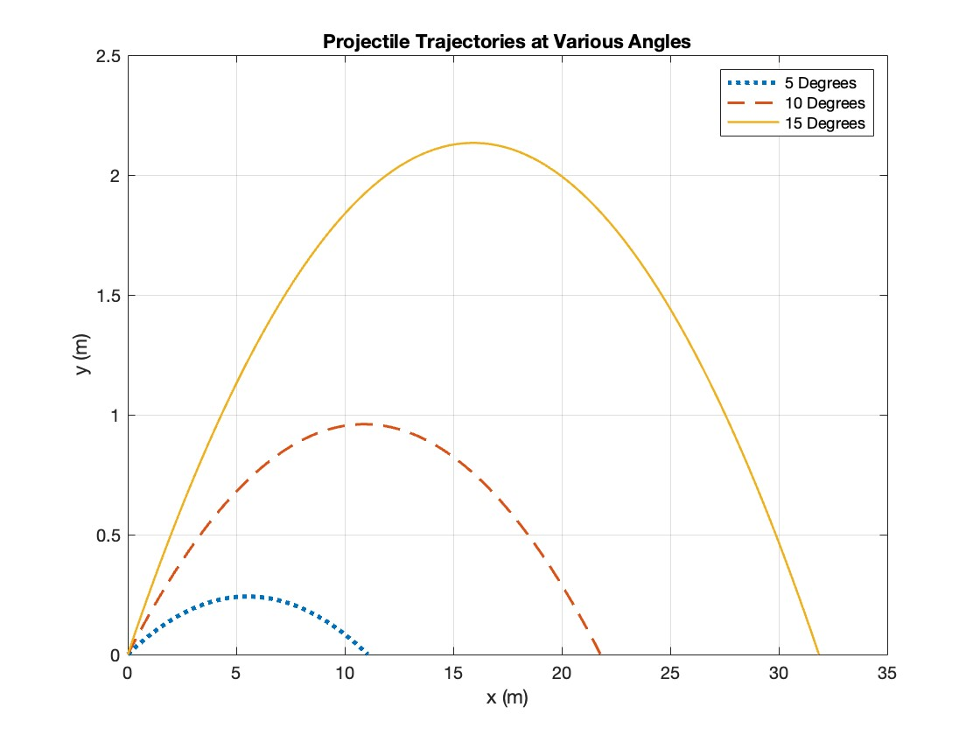
Projectile Motion
This is our goal!

